Slide 1



CAADP STRATEGY AND ACTION PLAN: 2026-2035
Presentation to PAFO WEBINAR
African Union Commission
April 15, 2025

Slide 2

1
A brief history of CAADP: Progress, Challenges and Looking Ahead
Presentation Outline
2
CAADP Strategy and Action Plan: 2026-2035
3
Key Political Processes Towards Kampala 2025
4
Requests to the Executive Council

Slide 3


CAADP: A Brief History

Slide 4
One of our flagship strategies towards realization of the African Union’s Agenda 2063 – The Africa We Want
Implemented through ten-year successive Strategies and Action Plans
CAADP: A Brief History

Slide 5
2003 – 2013
2014 – 2025
CAADP: A Brief History
Maputo Declaration
Allocate 10 percent of national budgets to agriculture
Achieve productivity growth of at least six percent/year
Malabo Declaration
Added commitments related to hunger, malnutrition, poverty, intra-African trade, resilience, and mutual accountability

Slide 6
1 - AGENDA SETTING
Raised agriculture's significance and profile in national, regional, and continental agendas
CAADP Progress and Achievements: 2003-2024
I. Enhanced Political Profile of Agriculture
2 - INVESTMENTS
Increased investment in agriculture across African countries
3 - OWNERSHIP
Strengthened African ownership and leadership in agricultural development

Slide 7
1 – ADOPTING CAADP
Countries signed CAADP Compacts as a sign of commitment -45
CAADP Progress and Achievements: 2003-2024
II. Strengthened National and Regional Planning Systems
2 – NATIONAL PLANNING
Development of National Agricultural Investment Plans (NAIPs) - 35
3 – REGIONAL PLANNING
Establishment of Regional Agricultural Investment Plans (RAIPs) - 4
4- POLICY ENHANCEMENT
Linked agricultural policies to economic policies, with a target of reducing poverty

Slide 8
1 – TRACKING COMMITMENTS
CAADP Progress and Achievements: 2003-2024
III. Established a Robust Monitoring and Reporting Mechanism
Established a robust monitoring and reporting mechanism, the CAADP Biennial Review (BR)
2 – UPSCALING BEST PRACTICES
The CAADP BR mechanism will be taken forward in the CAADP Strategy and Action Plan: 2026-2035

Slide 9
Despite these achievements, CAADP implementation has been slow, and no country is on track to meet the Malabo Declaration commitments by 2025. As a result:
CAADP Challenges: 2003-2024
Rising costs have made healthy diets unaffordable for 925 million people
280 million Africans (20 %) experience hunger
Growing rates of obesity and related issues add to the continent’s health and economic burden
Malnutrition remains a severe issue

Slide 10
Urbanization and changing consumption patterns, leading to greater demand for prepared and processed foods
Explosive population growth, leading to a significant increase in food demand that can be met only through productivity and efficiency gains
Climate change, environmental sustainability, and social stability, which affect efforts to increase agricultural productivity
CAADP: Looking Forward – Drivers of Africa’s Agrifood Systems Over the Next Ten Years
Urbanization
Economic Growth
Population Growth
Innovation
Resilience
Economic growth and rising incomes, increasing the demand for diverse, high-quality food products
Technological innovations, such as digital agriculture and biotechnology, with the potential to enhance productivity, sustainability, and inclusivity

Slide 11
CAADP Strategy and Action Plan: 2026-2035: An Overview

Slide 12
The African Union undertook an open, consultative process to develop the CAADP Strategy and Action Plan: 2026-2035. This process included:
1
2
3
4
Post-Malabo CAADP Agenda Development Process
Stakeholders’ engagement
Stakeholders’
engagement
Stakeholders’ engagement
Stakeholders’ engagement
Five regional dialogues, each led by one of the AU Regional Economic Communities
Technical roundtables with key stakeholders (youth, parliamentarians, etc.)
Consultations and dialogues with key CAADP stakeholder groups, including youth, women, non-state actors, parliamentarians, and the private sector
An open call for independent memoranda, resulting in 50 submissions by individuals and groups
5
6
7
Evidence & Analysis
Drafting
Validation
Thirteen technical working groups and a process to obtain technical expertise and review
An intensive, ten-day, collaborative “write shop,” where AU technical experts synthesized all stakeholder input, translating it into the CAADP Strategy and Action Plan: 2026-2035
A stakeholder validation workshop on the draft CAADP Strategy and Action Plan

Slide 13

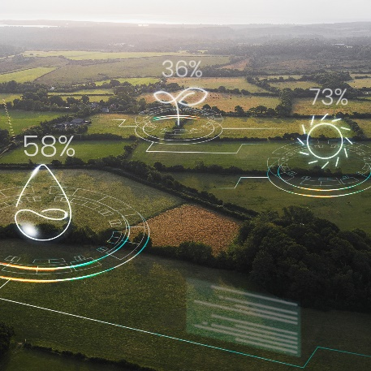
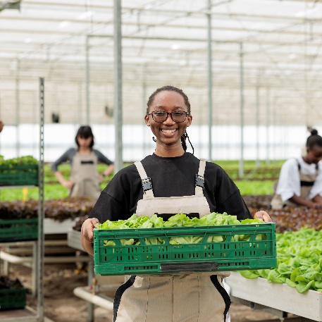
Adopts an agrifood systems approach
Calls for multi-sectoral coordination, increased investments, and the adoption of innovative practices
Aims to achieve sustainable, resilient, and inclusive agrifood systems transformation that diversify economies, create millions of local jobs, raise incomes, build social cohesion, and improve socio-economic stability
CAADP Strategy and Action Plan: 2026-2035: Key Features

Slide 14
CAADP Strategy and Action Plan: 2026-2035: Strategic Objectives
1.
Intensify sustainable food production, agro-industrialization, and trade
2.
Boost investment and financing in transforming agrifood systems
3.
Ensure food and nutrition security across the continent
Build resilient agrifood systems that can withstand and adapt to various shocks and stressors
4.
Advance inclusivity and equitable livelihoods
5.
6.
Strengthen agrifood systems governance

Slide 15

Strategic Objective 1
Intensify sustainable food production, agro-industrialization, and trade
CAADP Strategy and Action Plan: 2026-2035: Strategic Objectives
Key Interventions
Strengthen input systems
Stimulate growth, competitiveness, and sustainability
Invest in regional value chains
Improve trade-facilitating policies, infrastructure, and services
Intermediate Outcomes
Widespread adoption of sustainable practices
Increased productivity
Sustained growth in agro-processing
Enhanced trade efficiency

Slide 16

Strategic Objective 2
Boost investment and financing in transforming agri-food systems
Strategic Objective 2
Boost investment and financing in transforming agri-food systems
Key Interventions
Improve the quality of investments
Redesign a fit-for-purpose financial architecture
Strengthen facilities that support the development of bankable flagship projects
Intermediate Outcomes
Increased public and private investments
Wider availability of diverse and innovative financial products
Enhanced productivity
Strengthened financial institutions

Slide 17
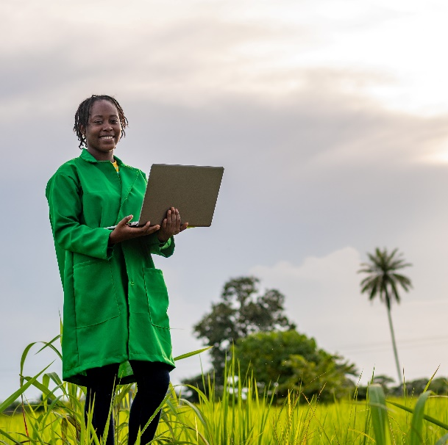
Strategic Objective 3
Ensure food and nutrition security
Strategic Objective 3
Ensure food and nutrition security
Key Interventions
Increase sustainable agricultural practices for enhanced productivity and biodiversity
Exploit agriculture to improve nutrition, health, and One Health outcomes
Strengthen SPS standards and One Health protocols
Intermediate Outcomes
Improved food and nutrition outcomes
Diversified diets
Reduced foodborne diseases

Slide 18
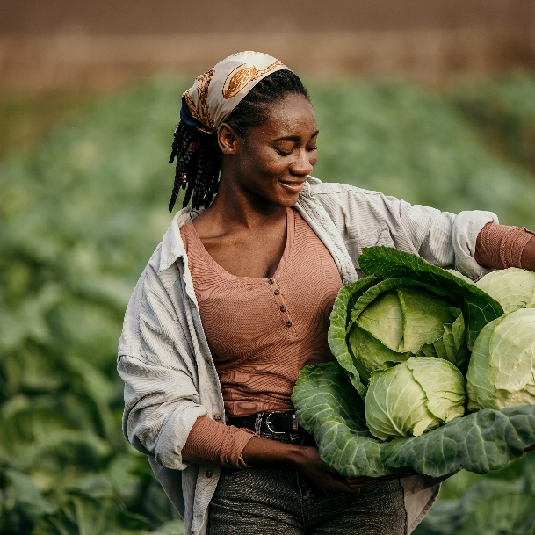
Strategic Objective 4
Advance inclusivity and equitable livelihoods
Strategic Objective 4
Advance inclusivity and equitable livelihoods
Key Interventions
Improve access to productive resources
Implement inclusive social protection programs
Promote digitalization and agri-tech
Improve market access and integration
Intermediate Outcomes
Equitable access to resources and opportunities across gender and age
Empowered smallholder farmers and communities
Enhanced social safety nets

Slide 19
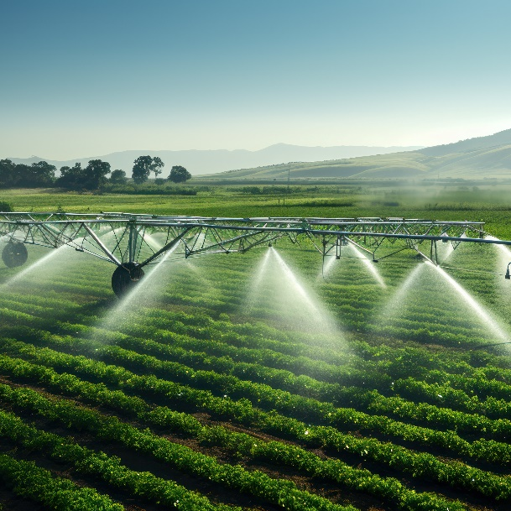
Strategic Objective 5
Build resilient agri-food systems that can withstand and adapt to various shocks and stressors
Strategic Objective 5
Build resilient agri-food systems that can withstand and adapt to various shocks and stressors
Key Interventions
Strengthen institutional infrastructure to address shocks and stressors
Institute and strengthen programs that build livelihood resilience
Intermediate Outcomes
Increased resilience to shocks and stressors
Improved risk management tools
Greater food diversity
Improved agri-food systems infrastructure

Slide 20



Strategic Objective 6
Strengthen agri-food systems governance
Strategic Objective 6
Strengthen agri-food systems governance
Leadership & Ownership:
Integrate the Kampala Declaration into national and regional development plans
Improve resource mobilization
Streamline involvement of non-state actors
Strengthen parliamentary oversight
Policy & Governance Coherence:
Streamline policy alignment across sectors at all levels
Enhance decentralization of CAADP implementation
Strengthen local governance
Strengthen institutional capacities
Evidence-Based Decision-Making & Mutual Accountability:
Establish a robust agri-food systems knowledge support system
Promote mutual accountability mechanisms
Institutionalize agricultural joint sector reviews

Slide 21



Strengthening Implementation and Coordination
Strengthening Implementation and Coordination
Strengthen institutional and human capacity at all levels (national, regional, and continental)
Foster coordination and collaboration among implementing entities at all levels
Enhance resource mobilization and financial sustainability

Slide 22
Resourcing the CAADP Strategy and Action Plan: 2026-2035
Resourcing the CAADP Strategy and Action Plan: 2026-2035
Strengthen public funding
AU bodies mentor Member States on increasing budget allocations
AU Member States conduct regular public expenditure reviews
Create a special fund for AU institutions
Pool Member State, donor, and private sector resources to cover the cost of Member State support and continental activities
Leverage donor funding for capacity building
Use donor funds to build implementing partner capacity through training, knowledge-sharing, technical assistance, and the provision of technical tools
Enhance private sector engagement
Create an enabling environment for private investment in infrastructure, technology, and capacity building.
Incorporate green financing into implementation support
Use green financing for direct investments and to support the implementation of climate-smart agriculture efforts, among other
Mobilize revenues from mineral exploitation
Earmark a portion of revenues for a dedicated fund (or AU entities) set aside for capacity building, infrastructure development, or CAADP implementation.

Slide 23

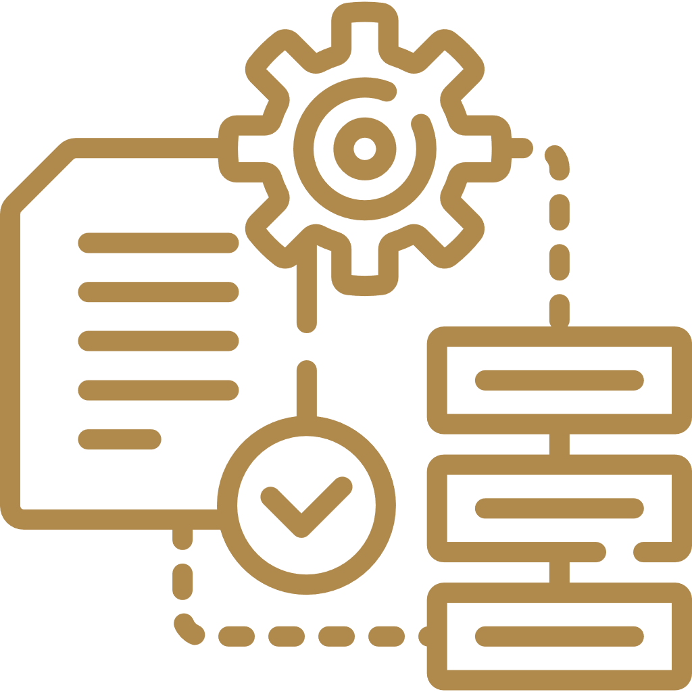
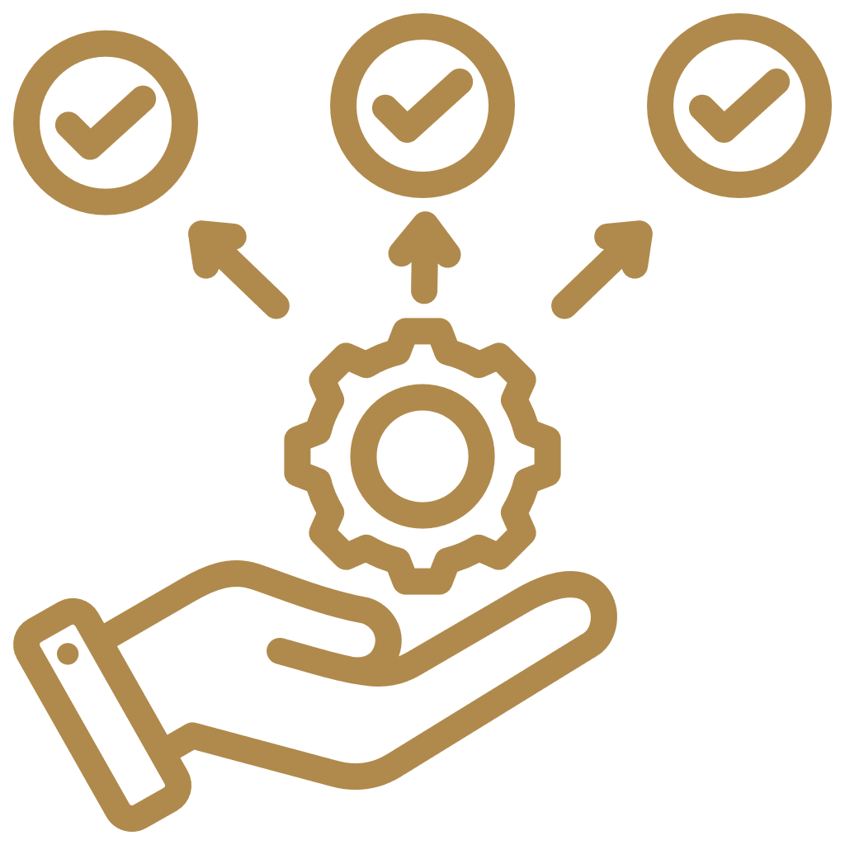
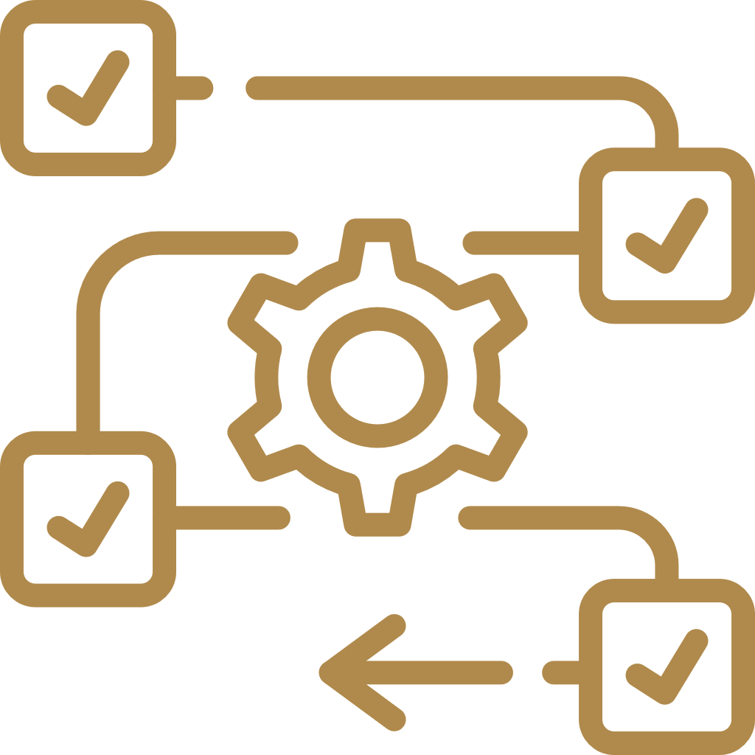
Knowledge Support System, Communications, and Advocacy
Knowledge Support System, Communications, and Advocacy
Strengthen the M&E framework | Strengthen reporting systems | Deploy a minimum level of capacity at each level (continental, regional, and national) | Improve communications and enhance advocacy on CAADP

Slide 24
Enhancing the CAADP Knowledge and Support System
Enhancing the CAADP Knowledge and Support System
Strengthen the M&E framework Update and align the progress monitoring indicators with the new CAADP Strategy and Action Plan | Strengthen reporting systems Build system capacity to produce BR Reports, track National Agri-Food Investment Plans, and provide data for decision-making | Deploy a minimum level of capacity at each level Designate an M&E team at the country level to collect, synthesize, manage, and report performance data for CAADP investments

Slide 25
Improving CAADP Communications and Advocacy
Improving CAADP Communications and Advocacy
COMMUNICATIONS Develop a CAADP Communications Strategy Build the communications capacity of key stakeholders Raise awareness of CAADP | ADVOCACY Develop and implement a CAADP Advocacy Strategy Put in place collaborative frameworks and processes Improve non-state actor engagement

Slide 26
Key Political Processes Towards Kampala

Slide 27
Key Process Milestones
Key Process Milestones
Extraordinary Session of the STC on ARDWE: October 23-25, 2024 (Addis/Hybrid)
01
Permanent Representatives Committee (PRC) Briefing: Early December 2024
02
Extraordinary Session of AU Assembly: January 9-11, 2025 (Kampala, Uganda)
03

Slide 28
Advocacy and Policy Influence:
Capacity Building:
ROLES OF FARMERS ORGANISATION IN THE IMPLEMENTATION OF THE KAMPALA DECLARATION
Investment Mobilization:
01
Market Access and Trade Facilitation
Monitoring and Accountability
Community Engagement
03

Slide 29

Asante | Gracias
Merci | Obrigado
Shukran | Thank you

